Slide 1
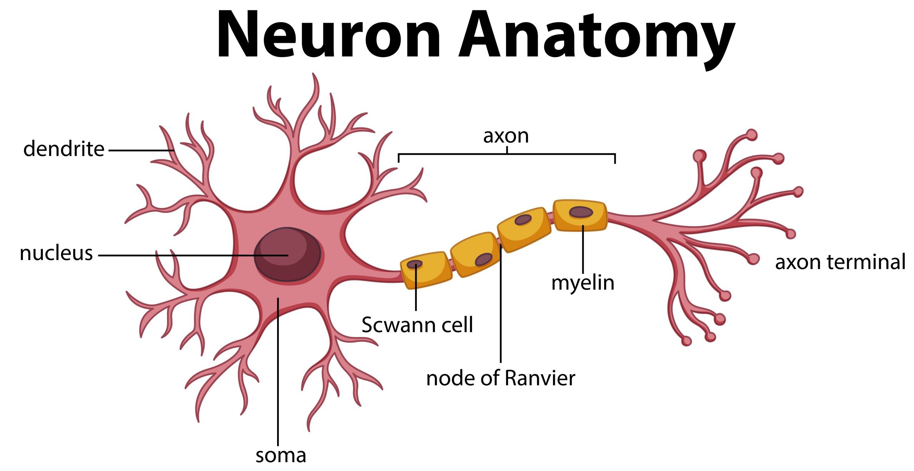

Slide 2
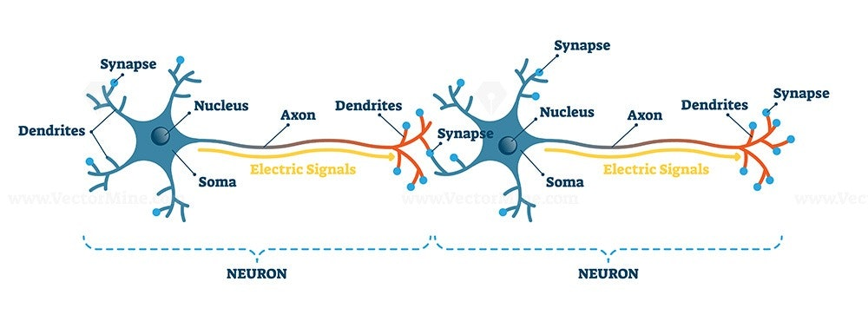
Neuron – Neuron Interconnection

Slide 3
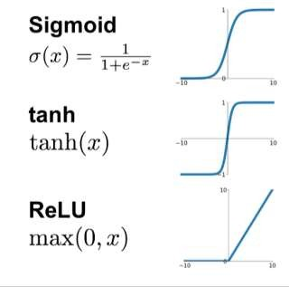
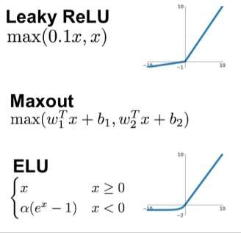
Why we use Activation functions
Activation functions are really important for a Artificial Neural Network to learn and make sense Non-linear complex functional mappings between the inputs and response variable.
They introduce non-linear properties to our Network. Their main purpose is to convert a input signal of a node in a A-NN to an output signal. That output signal now is used as a input in the next layer in the stack.
https://ai.stackexchange.com/questions/5493/what-is-the-purpose-of-an-activation-function-in-neural-networks
3

Slide 4
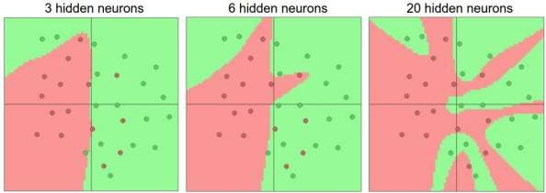
why can’t we do it without activating the input signal
A linear equation is easy to solve but they are limited in their complexity and have less power to learn complex functional mappings from data. A Neural Network without Activation function would simply be a Linear regression Model, which has limited power and does not performs good most of the times.
That is why we use Artificial Neural network techniques such as Deep learning to make sense of something complicated ,high dimensional, non-linear -big datasets, where the model has lots and lots of hidden layers in between and has a very complicated architecture which helps us to make sense and extract knowledge form such complicated big datasets.
https://towardsdatascience.com/activation-functions-neural-networks-1cbd9f8d91d6
4

Slide 5
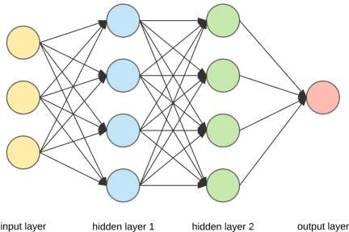
The Layers of a Neural Network
3 types of layers in neural network:
Input layer — It is used to pass in our input(an image, text or any suitable type of data for NN).
Hidden Layer — These are the layers in between the input and output layers.These layers are responsible for learning the mapping between input and output. (i.e. in the dog and cat gif above, the hidden layers are the ones responsible to learn that the dog picture is linked to the name dog, and it does this through a series of matrix multiplications and mathematical transformations to learn these mappings).
Output Layer — This layer is responsible for giving us the output of
the NN given our inputs.
5

Slide 6

Cost Function
A Cost Function/Loss Function evaluates the performance of our Machine Learning Algorithm. The Loss function computes the error for a single training example while the Cost function is the average of the loss functions for all the training examples.
The goal of any Learning Algorithm is to minimize the Cost Function.
lower error between the actual and the predicted values signifies that the algorithm has
done a good job in learning.
A common measure of the discrepancy between the two values is the ”Cross-entropy”
6

Slide 7
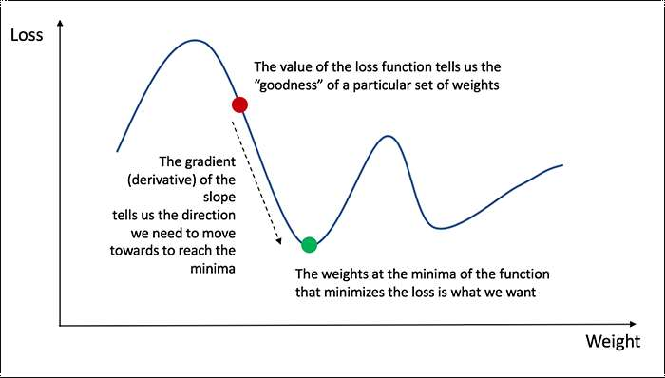
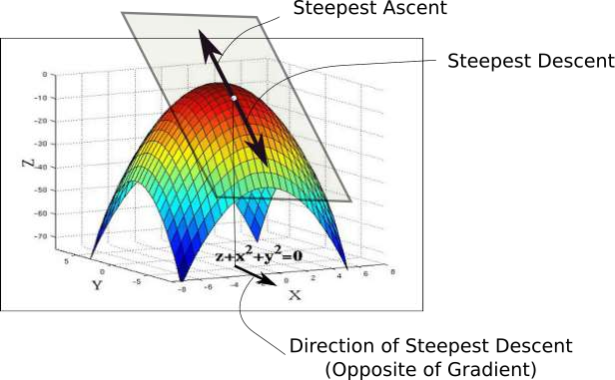
Gradient Descent
While the direction of the gradient tells us which direction has the steepest ascent, it's magnitude tells us how steep the steepest ascent/descent is. So, at the minima, where the contour is almost flat, you would expect the gradient to be almost zero. In fact, it's precisely zero for the point of minima.
Gradient descent is an optimization algorithm used to minimize some function by iteratively moving in the direction of steepest descent as defined by the negative of the gradient
7

Slide 8
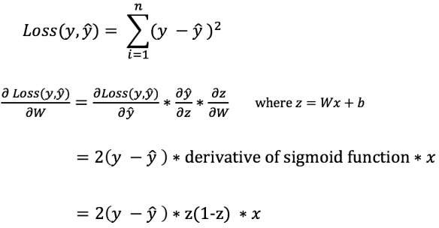
Backward Propagation
we can’t directly calculate the derivative of the loss function with respect to the weights and biases because the equation of the loss function does not contain the weights and biases. Therefore, we need the chain rule to help us calculate it.
8

Slide 9
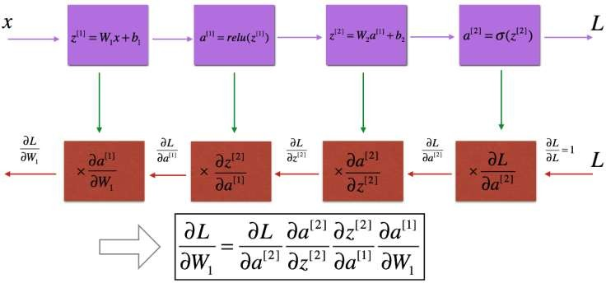
Backward Propagation
We know that propagation is used to calculate the gradient of the loss function with respect
to the parameters.
9

Slide 10
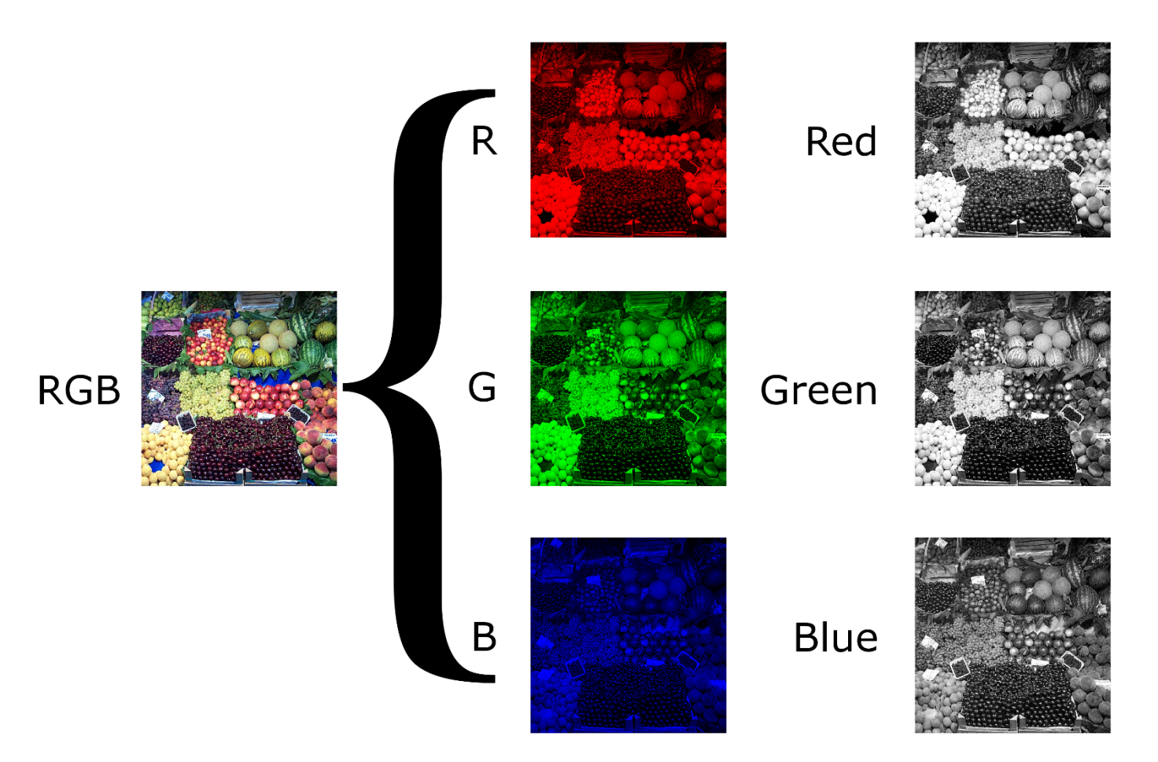
CNN
Color Images

Slide 11
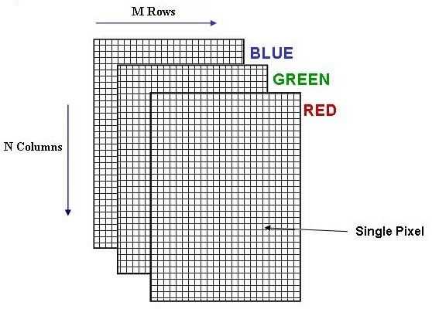
Introduction
Color Images

Slide 12
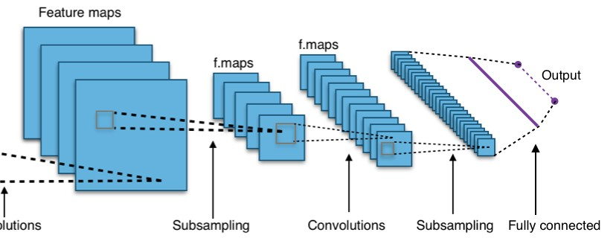
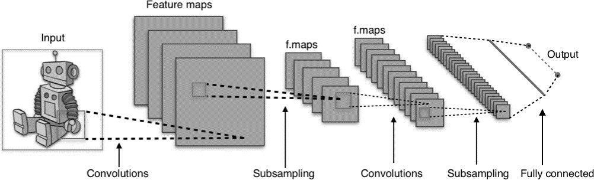
Convolutional Neural Networks (CNNs)
Network Architecture
Convolutional Layer, Pooling Layer, Fully Connected Layer

Slide 13
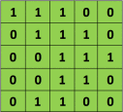
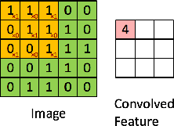

Convolutional Neural Networks (CNNs)
x
=
Input Image (I)
Filter (K)
The 3×3 matrix (K) is called a ‘filter‘ or ‘kernel’ or ‘feature detector’ and the matrix formed by sliding the filter over the image and computing the dot product is called the ‘Convolved Feature’ or ‘Activation Map’ or the ‘Feature Map‘.
Slide 17

Slide 14
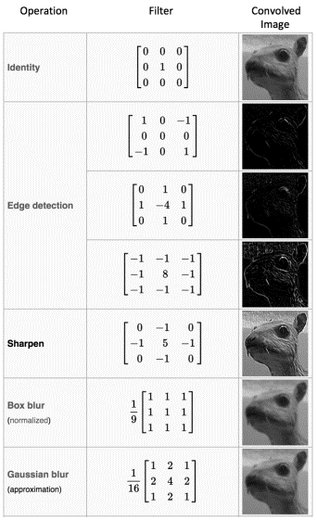

Convolutional Neural Networks (CNNs)
Convolution Operator
Different different
filters
Feature
will produce
Maps for the
same input image. For example:
Input Image
Slide 20

Slide 15
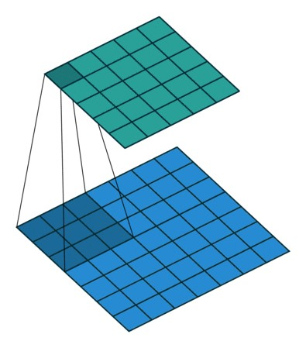


Convolutional Neural Networks (CNNs)
Convolutional Layer
In practice, a CNN learns the values of these filters on its own during the training process
Although we still need to specify parameters such as number of filters, filter size, padding, and stride before the training process
Slide 23

Slide 16
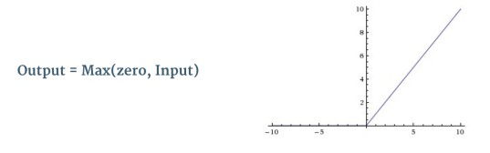
Convolutional Neural Networks (CNNs)
Activation Layer (ReLU)
An additional operation called Rectified Linear Unit (ReLU) has been used after every Convolution operation
Basically, ReLU is an element wise operation (applied per pixel) and replaces all negative pixel values in the feature map by zero
The purpose of ReLU is to introduce non-linearity to the network
Slide 24

Slide 17
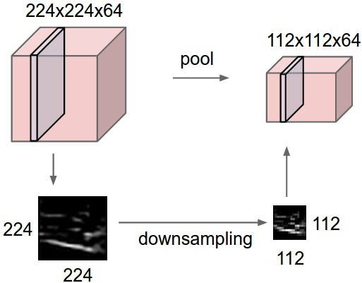
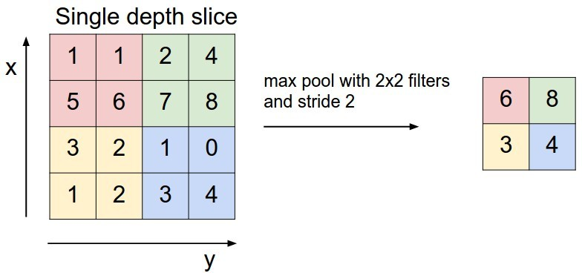
Convolutional Neural Networks (CNNs)
Pooling Layer
Pooling layer downsamples the volume spatially, independently in
each depth slice of the input
The most common downsampling operation is max, giving rise to max pooling, here shown with a stride of 2
Slide 26

Slide 18
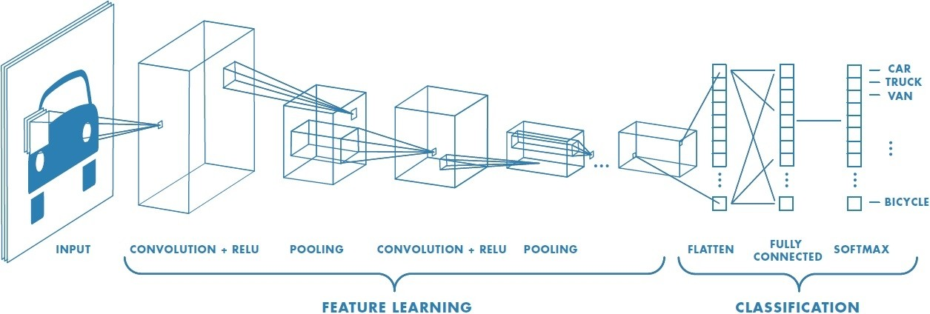
Convolutional Neural Networks (CNNs)
Fully Connected Layer
Neurons in a fully connected layer have full connections to all activations in the previous layer, as seen in regular neural networks

Slide 19
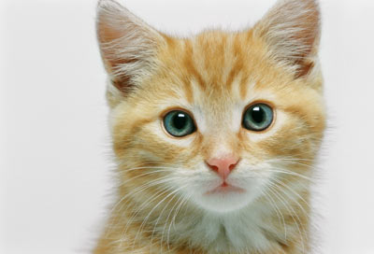
The whole CNN
3
0
-1
1
Convolution
3
1
0
3
Max Pooling
Can repeat many times
A new image
Convolution
Smaller than the original image
The number of channels is the number of filters
Max Pooling

Slide 20
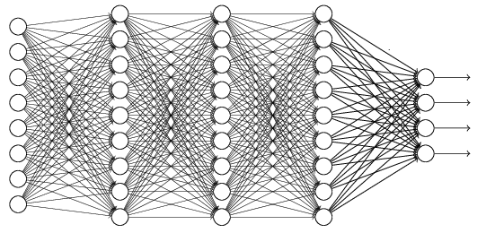
The whole CNN
cat dog ……
Convolution
Max Pooling
Fully Connected Feedforward network
A new image
Convolution
Max Pooling
Flattened
A new image

Slide 21


CNN in Keras
Only modified the network structure and input format (vector -> 3-D tensor)
input
Convolution
1 | -1 | -1
-1 | 1 | -1
-1 | -1 | 1
-1 | 1 | -1
-1 | 1 | -1
-1 | 1 | -1
There are 25 3x3 filters.
……
Max Pooling
Input_shape = ( 28 , 28 , 1)
28 x 28 pixels
1: black/white, 3: RGB
Convolution
3
-1
3
Max Pooling
-3
1

Slide 22
CNN in Keras
Only modified the network structure and input format (vector -> 3-D array)
Input
1 x 28 x 28
Convolution
How many parameters for each filter?
9
25 x 26 x 26
Max Pooling
25 x 13 x 13
Convolution
How many parameters
for each filter?
225=
25x9
50 x 11 x 11
Max Pooling
50 x 5 x 5

Slide 23
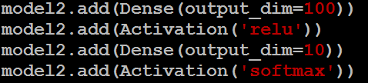
CNN in Keras
Only modified the network structure and input format (vector -> 3-D array)
Input
1 x 28 x 28
Output
Convolution
25 x 26 x 26
Fully connected feedforward network
Max Pooling
25 x 13 x 13
Convolution
50 x 11 x 11
Max Pooling
1250
50 x 5 x 5
Flattened

Slide 24
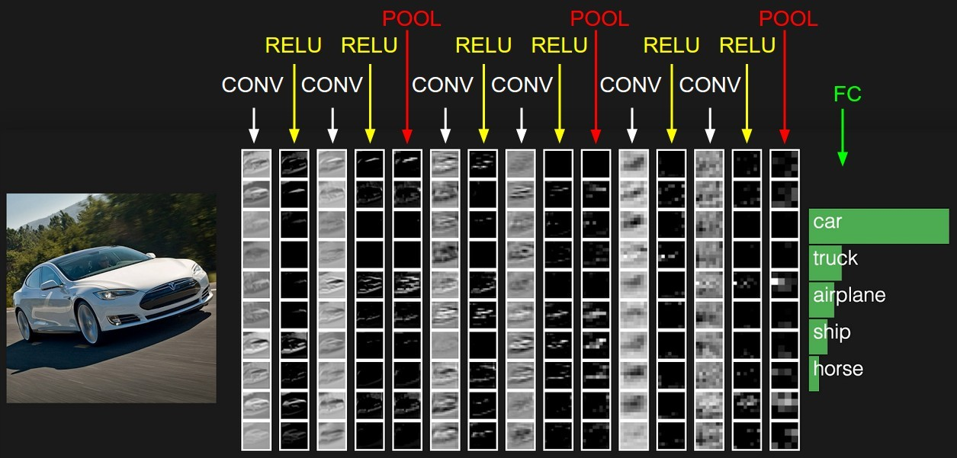
Convolutional Neural Networks (CNNs)
Example: Input >> [ [ Conv >> ReLU ] * 2 >> Pool ] * 3 >> FC

Slide 25
Introduction to RNN and LSTM

Slide 26
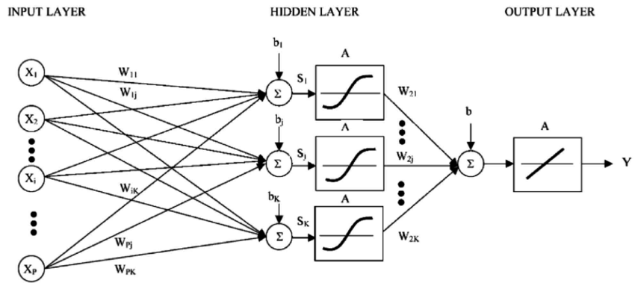
Traditional Neural Network
Input Layer
Hidden Layers
Output Layer
Activation
Notes:
Input, hidden, output layers,
The output of one layer is the linear combination of the output of previous layers followed by an activation func

Slide 27
Sequence Problems
The output depends on
  Current Input
  Previous Output
Traditional neural network cannot capture such relationship
Notes:
One class of classic classification problem is called

Slide 28
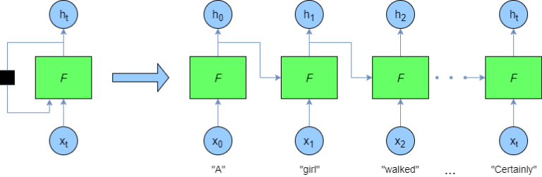
Recurrent Neural Network
Use the previous output as the input of current network
Notes:
The only difference from NN
Two ways to illustrate RNN, rolled and unrolled expression

Slide 29
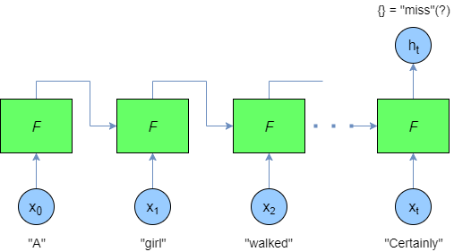
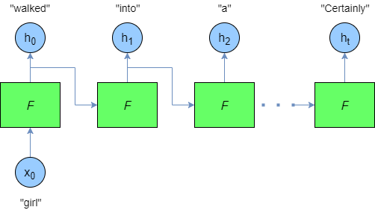
Different Configurations
Notes:
Many to one (only care about the last output)
One to Many (auto-completion)

Slide 30
Problem of RNN
The Concept of RNN is great
Having a practical problem for training RNN
Notes:
The motivation for RNN is to learn the dependency between the current output and previous inputs
When the separation between them is long
There will be gradient vanishing problem

Slide 31


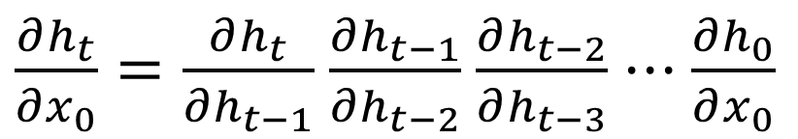
Gradient Vanishing
The dependency between $h_{t}$ and $x_{0}$ can be described by
It can be factorized into
$$\frac{∂h_{t}}{∂x_{0}}$$
$\frac{∂h_{t}}{∂x_{0}}=\frac{∂h_{t}}{∂h_{t−1}}$ $\frac{∂h_{t−1}}{∂h_{t−2}}$ $\frac{∂h_{t−2}}{∂h_{t−3}}$ $⋅⋅⋅\frac{∂h_{0}}{∂x_{0}}$

Slide 32
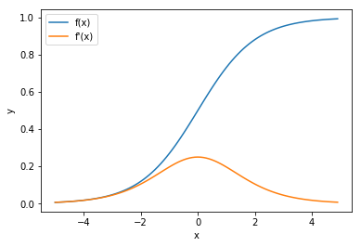
The Values of Derivative
Depending on the activation functions
Notes:
Common activation functions sigmoid
The final math op to derive the output is the activation

Slide 33
What’s the results
The partial derivative is close to zero
The output is not related to far pervious inputs
Long dependency is vanishing

Slide 34
Solutions
Change activation functions
  The problem can be alleviated somewhat but not eliminated
  May affect the learning performance
LSTM

Slide 35
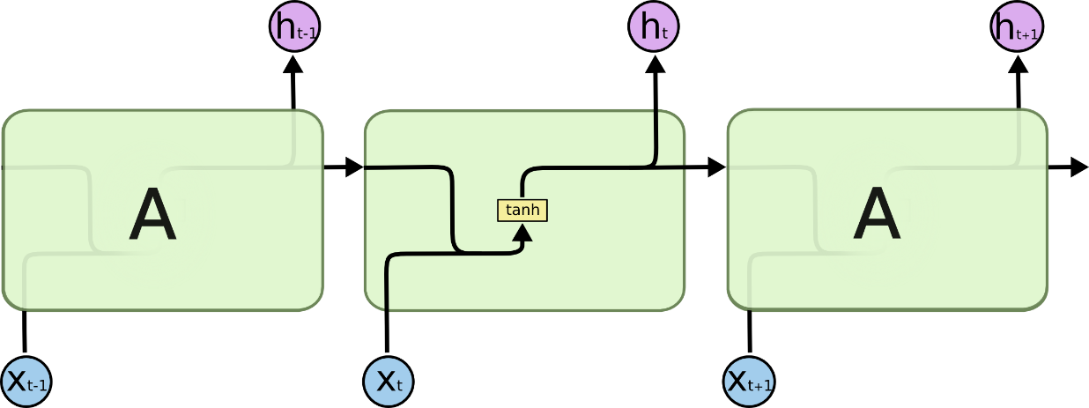
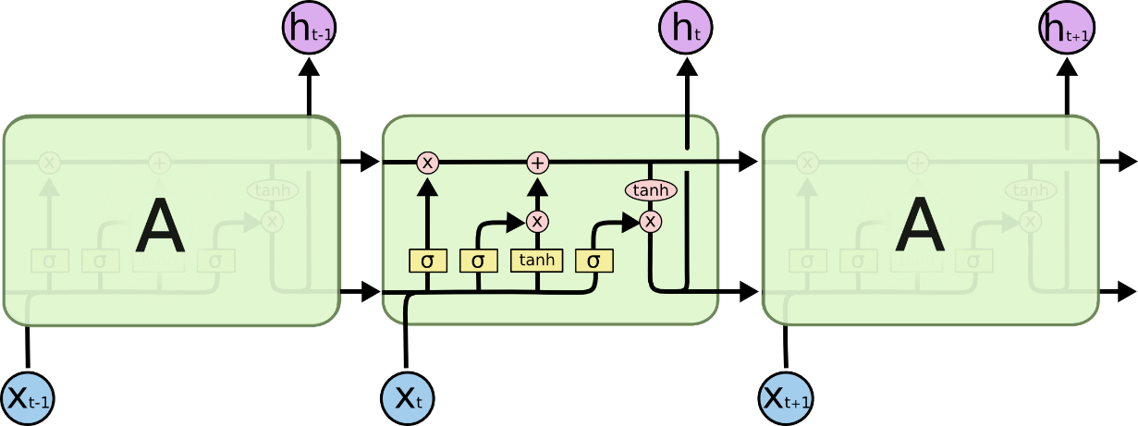
Long Short-Term Memory
Key insights: build a direct path from previous inputs to the current output

Slide 36
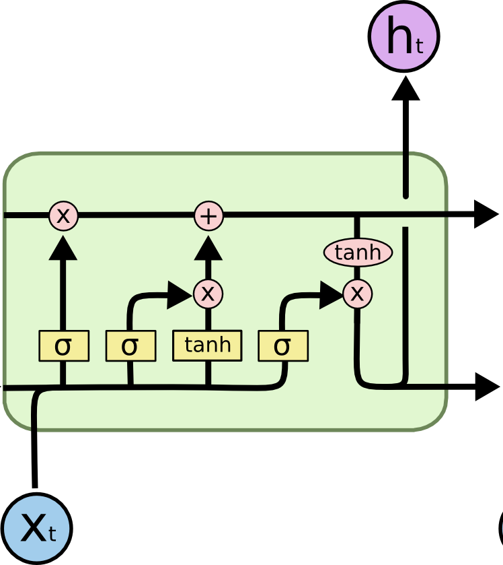
LSTM Breakdown
Hidden states
Input gates
Forget gates
Output gates

Slide 37
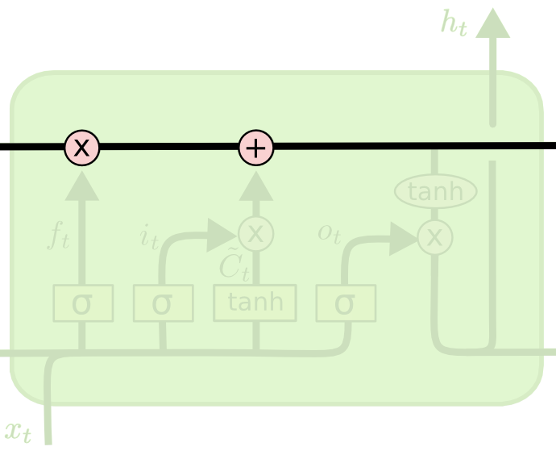
Hidden States
Carry previous information
Build a direct path

Slide 38
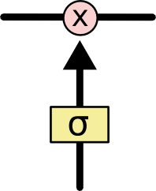

Gates
A neural network $σ$
Output range [0, 1]
Pointwise multiplication
Filtering function

Slide 39
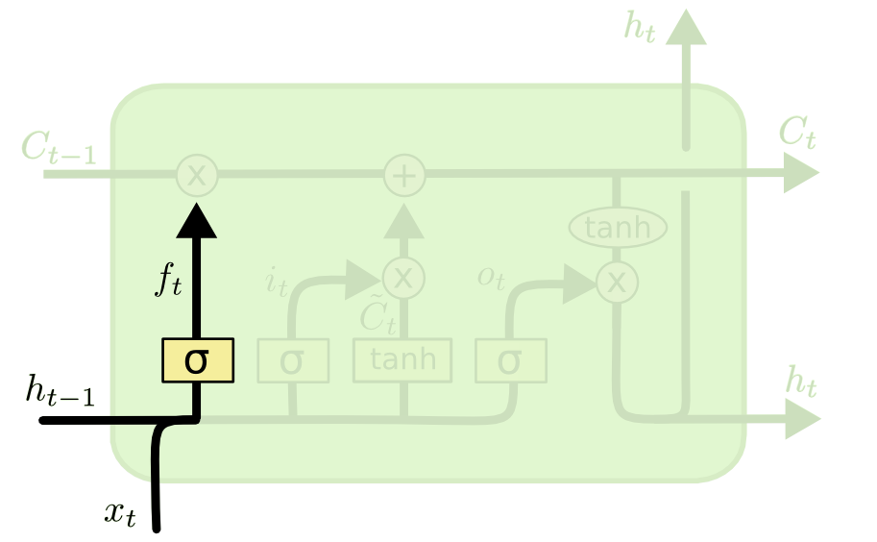
Forget gate
What is kept from previous states

Slide 40
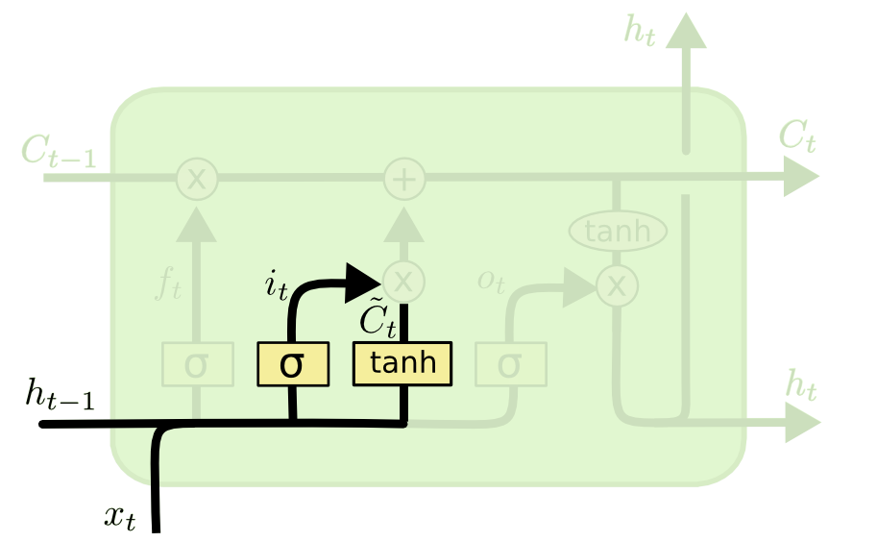
Input Gate
What is added to the hidden state

Slide 41
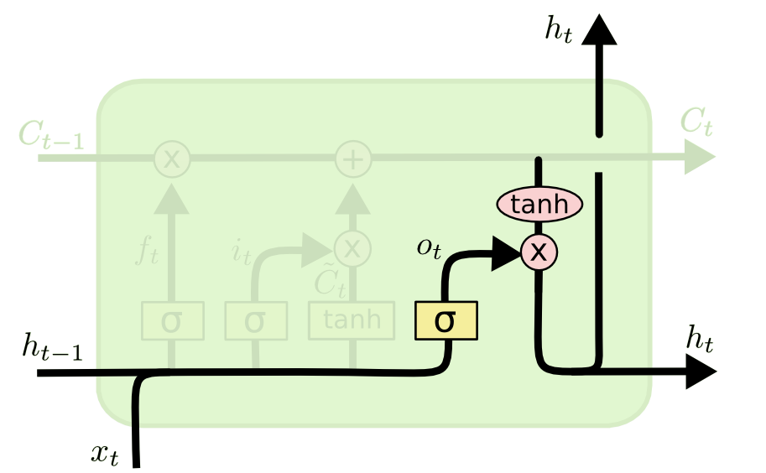
Output Gates
What is reported as output

Slide 42
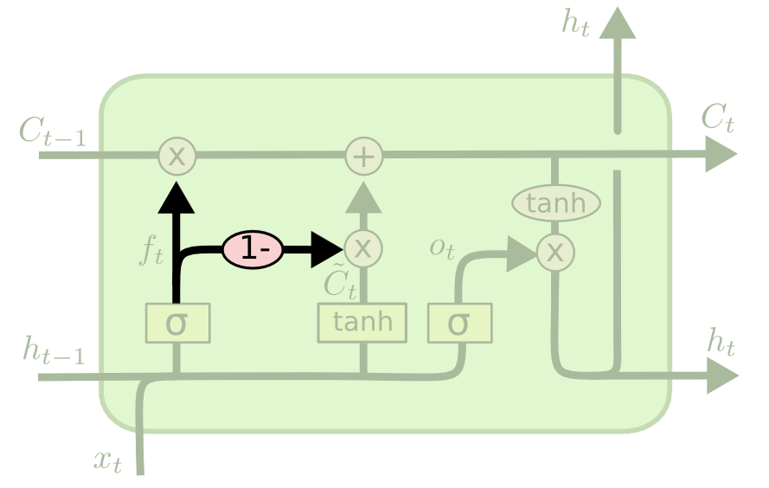
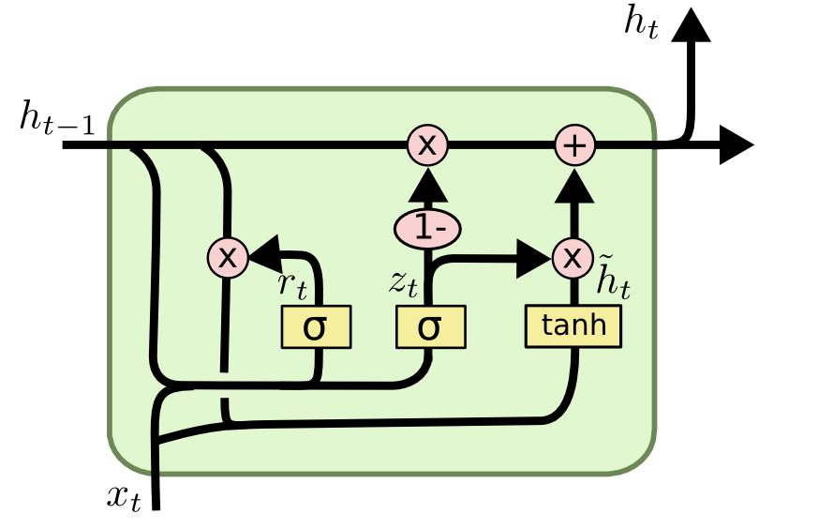
LSTM Variants

Slide 43
Conclusion
RNN is used for sequence / time-series problem
1
Gradient vanishing problem limits its effectiveness
2
LSTM cell to eliminate problem
3
Practically LSTM works much better than RNN
4

